Slide 1
M7

Slide 2

Means of spread
How do infectious diseases spread?

Slide 3
Means of spread
Many microbial agents can commonly move from an affected person to someone else in a variety of ways.
In other words, they can be ‘communicated’, and so are also called communicable diseases.

Slide 4

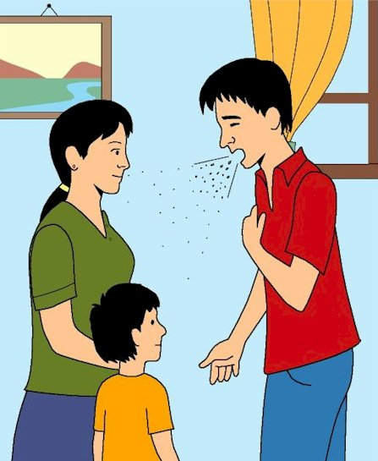
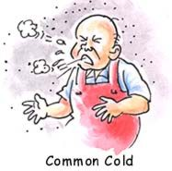
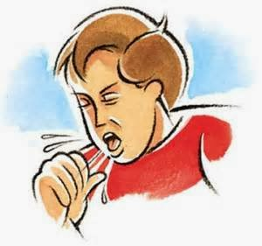
1.
Air
This occurs through the little droplets thrown out by an infected person who sneezes or coughs.
Such airborne diseases will spread.
Someone standing close by can breathe in these droplets, and the microbes get a chance to start a new infection.
Examples of such diseases spread through the air are the common cold, pneumonia and tuberculosis.

Slide 5
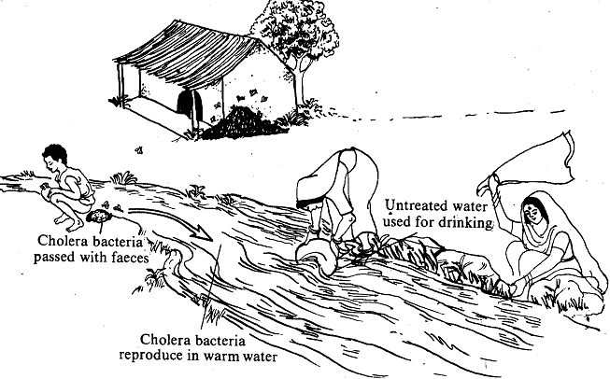
2.
Water
This occurs if the excreta from someone suffering from an infectious gut disease, such as cholera, get mixed with the drinking water used by people living nearby.
The cholera causing microbes will enter new hosts through the water they drink and cause disease in them.
Disease of intestine

Slide 6
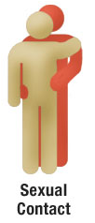
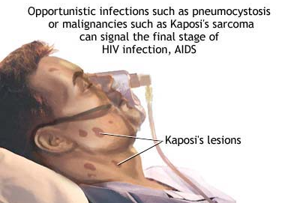

3.
Sexual contact
Sexual act is one of the closest physical contact two people can have with each other.
Not surprisingly, there are microbial diseases such as syphilis or AIDS that are transmitted by sexual contact from one partner to the other.
However, such sexually transmitted diseases are not spread by casual physical contact.
Casual physical contacts include handshakes or hugs or sports, like wrestling, or by any of the other ways in which we touch each other socially.

Slide 7

4.
Blood transfusion
Spread through blood-to-blood contact with infected people or from an infected mother to her baby during pregnancy or through breast feeding.

Slide 8
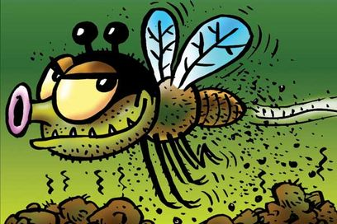
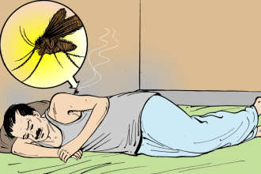
5.
Vectors
Animals carry the infecting agents from a sick person to another potential host.
These animals are thus the intermediaries and are called vectors.
The commonest vectors we all know are mosquitoes.
In many species of mosquitoes, the females need highly nutritious food in the form of blood in order to be able to lay mature eggs.
Mosquitoes feed on many warm-blooded animals, including us.
In this way, they can transfer diseases from person to person.

